Slide 1

Offer Acceptance Analysis
How can we improve?

Slide 2
Agenda
Define the problem
Analyze key drivers
Develop predictive model
Measure Accuracy
Results

Slide 3
Define the problem
Understand the demographics and other characteristics of the bank’s customers that accept a credit card offer and that do not accept a credit card.
Credit Card Services are a large revenue driver for the bank, however blindly offering to everyone is costly and inefficient. It is necessary to understand what our market looks like and who best to target..

Slide 4
Analyze Key Drivers
Information Collected:
Customer Number: A sequential number assigned to the customers (this column is hidden and excluded – this unique identifier will not be used directly).
Offer Accepted: Did the customer accept (Yes) or reject (No) the offer. Reward: The type of reward program offered for the card.
Mailer Type: Letter or postcard.
Income Level: Low, Medium, or High.
Bank Accounts Open: How many non-credit-card accounts are held by the customer.
Overdraft Protection: Does the customer have overdraft protection on their checking account(s) (Yes or No).
Credit Rating: Low, Medium, or High.
Credit Cards Held: The number of credit cards held at the bank.
Homes Owned: The number of homes owned by the customer.
Household Size: The number of individuals in the family.
Own Your Home: Does the customer own their home? (Yes or No).
Average Balance: Average account balance (across all accounts over time). Q1, Q2, Q3, and Q4
Balance
See Tableau Story for details on the analysis…

Slide 5
Develop Predictive Model
Logistic regression model:
The target variable is ‘offer accepted’ with values of yes or no. So, this is a classification problem.
See python for full model details...

Slide 6
Develop Predictive Model
Methodology:
Gather the Data
2. Explore the Data
3. Clean the Data
Categorical data:
needs to be grouped into fewer buckets
dropped if there are too many instances
cleaned if there are various values with the same meaning
Numerical data:
needs to be converted to number if object (may require functions for data transformations)
Dealing with Nulls
Dealing with Outliers
Transform numerical columns to conform to a more normal standard distribution
Check Multicollinearity (but no need to modify since logistic regression isn't impacted by multicollinearity)
Normalize and or standardize the data
Check and rectify data imbalance
Apply Train-Test Split
Train Model
Test Model

Slide 7
Measure Accuracy
Tested a variety of scaling methods:
Normalizer
Standard Scaler
Min – Max Scaler
Tested multiple data balancing methods:
Random Over Sampling
Random Under Sampling
SMOTE
Tomeklinks

Slide 8
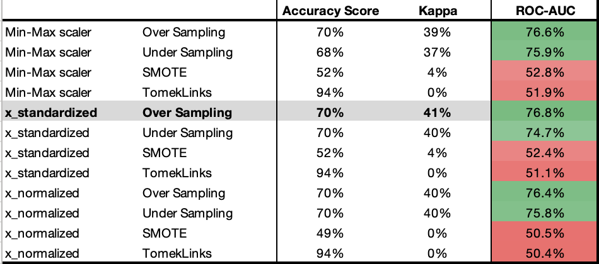
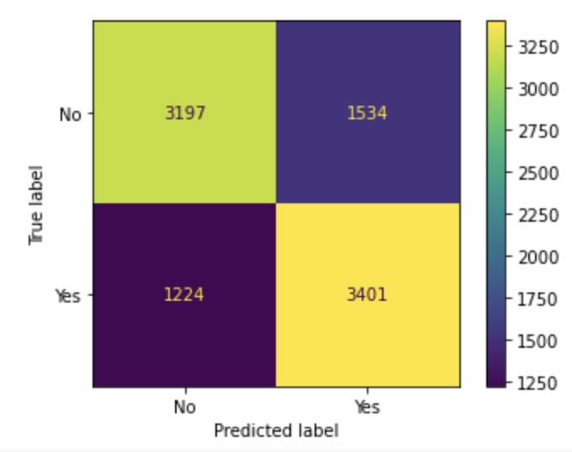
Results
Ultimately selected the methods that rendered the highest ROC-AUC score of 76.8%
Despite having the highest Kappa and ROCs (both within moderate range), the Accuracy score was only average compared to methods like tomeklinks, highlighting the skew data imbalance may have on a model.

